Slide 1
DEPENDENCY INJECTION
Weekend Sharing

Slide 2
D in Solid
Dependency Inversion Principle
“High-level classes shouldn’t depend on low-level classes. Both should depend on abstractions (interface)”

Slide 3
What is Interface?
Inside the interface only have name of the function
Every class implement from interface will define the function

Slide 4
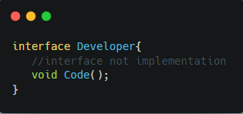
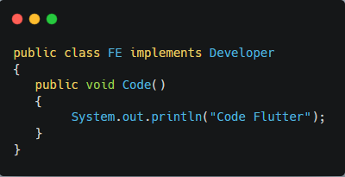
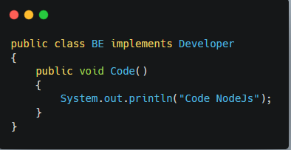
Example

Slide 5
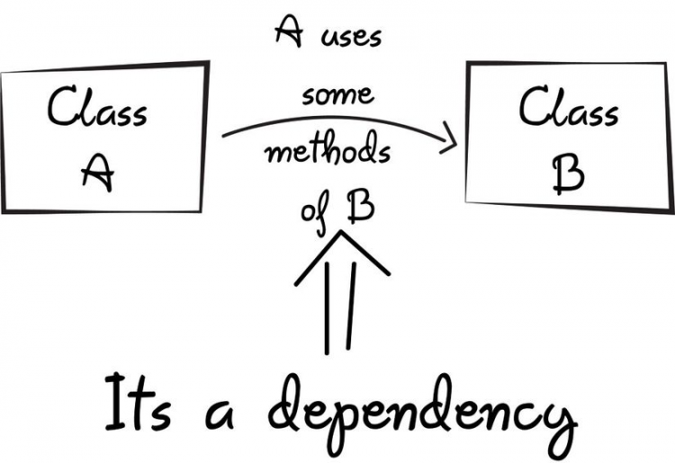
What is dependency?
Dependency is a type of relationship between two classes in which one class operates independently and other class depends on the other class
If class A uses class B ⇒ class A depends on class B ⬄ class B is a dependency of class A

Slide 6
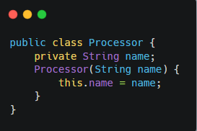
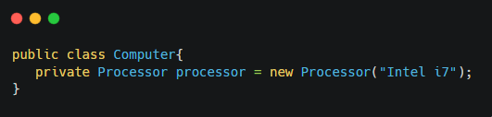
Example

Slide 7
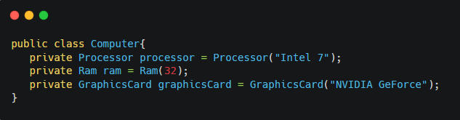

Get to the point
Is there any problem with this class?

Slide 8
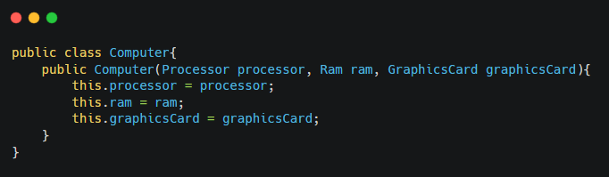
Solution

Slide 9
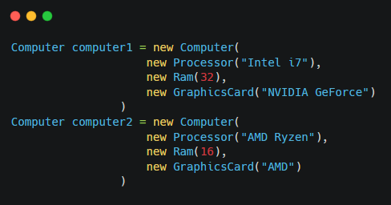
Solution

Slide 10

Demo code

Slide 11
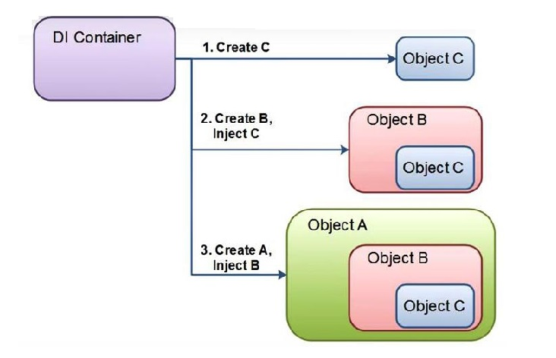
What is Dependency Injection?
Dependency Injection is a design pattern developed to minimized the dependency between classes. This will make the organization of the code “cleaner”, easier to understand and more intuitive

Slide 12
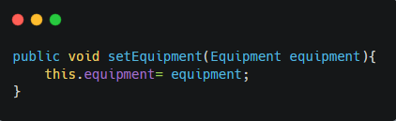
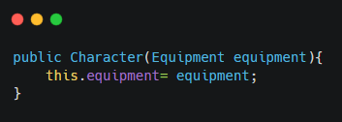
Types of Dependency Injection
Constructor injection
Setter injection
Interface injection

Slide 13
Pros & Cons
Pros | Cons
Cleaner code, easier to understand and easier to replace and maintain | It takes a lot of time for newbies to change their mindset from Dependency to Dependency Injection
Easier to write Unit test | Programmers will need to have many years of experience as well as thinking and have followed the SOLID principle
Easier to change the relationship between Objects | Complicated to learn, and overdoing it can lead to a number of other problems
Classes will not directly depend on each other, but instead they will link to each other through an Interface or base class | Dependency passed to runtime instead of compile time. Therefore, errors at compile time can be pushed to runtime. This will make debug more difficult

